Slide 1
Investment Strategy Report
$
A Comprehensive Analysis and Recommendation

Slide 2
Table of contents
01.
02.
03.
Market-overview
Strategic options
Background
04.
05.
06.
Choice of Investment
Projections
Financial plan

Slide 3
Background
I recently inherited R100,000, and as a twenty-five-year-old, I must decide how to make wise use of this money. I know that investing this money can put me on a path to financial security and future prosperity, despite the strong temptation to spend it on immediate wants and needs. I am aware of the importance of selecting the right investments, particularly in light of the market's volatility and the variety of available options. I am aware that investing in the stock market has the potential to offer greater returns than other investment options as I think about my options. I am aware that it carries some risk, though, and that risk need to be carefully managed. I intend to thoroughly examine the stock market and its prior performance in order to make a wise decision. To find potentially profitable investment opportunities, this will involve examining a range of economic indicators and market trends. To create a well-balanced investment portfolio that meets my needs, I will also consider my individual risk tolerance and investment goals. I'm eager to start this investment journey and see what this R100,000 can do for my future financial success.

Slide 4
Market overview
Indexes serve as a gauge for a group of stocks or other investments' performance. Among the most well-known indexes are the S&P 500, the Dow Jones Industrial Average, and the NASDAQ Composite. These indexes are frequently used to monitor the overall performance of the stock market and serve as benchmarks for many investors.
Investors can expose themselves to a variety of stocks or other investments through investment vehicles like broad-based unit trusts and ETFs. Investors can diversify their portfolios and lower risk with these investments because they are frequently made to track a specific market index or industry. The SPDR S&P 500 ETF, iShares Core MSCI EAFE ETF, and Vanguard Total Stock Market ETF are a few of the most well-known broad-based ETFs. The stock market can be effectively accessed, and potential long-term returns can be generated with these kinds of investments. They do, however, also involve risk, so they should be carefully evaluated in light of an investor's objectives and risk tolerance.

Slide 5
Investment Strategy Options
01
02
03
04
S&P 500
FTSE 100 (UK market)
Dow Jones Industrial Ave
NASDAQ Composite
01
02
03
Nikker 225
Shenzhen Index
CAC 40 Index (France)

Slide 6
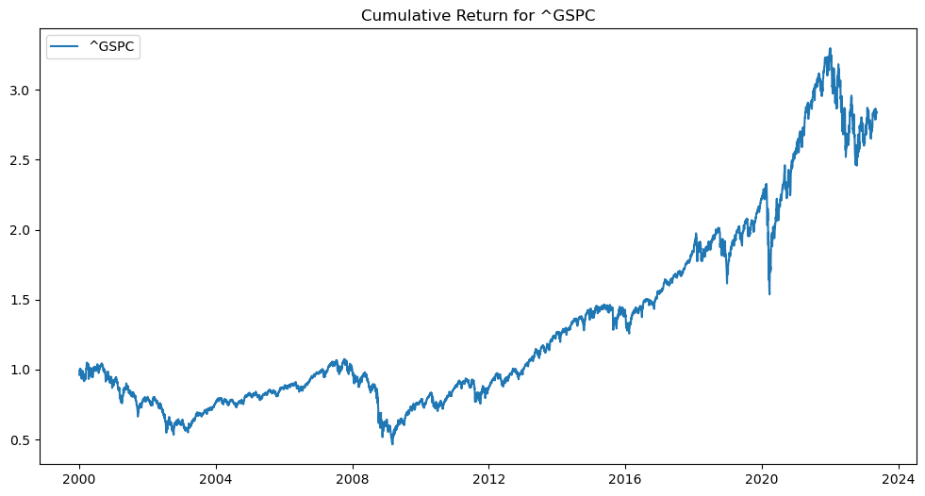
S&P 500
The S&P 500 is a stock market index that tracks the performance of 500 large-cap publicly traded companies in the United States. It's widely regarded as a barometer of the US stock market and is used as a benchmark for many investment portfolios.
Perfomamce

Slide 7
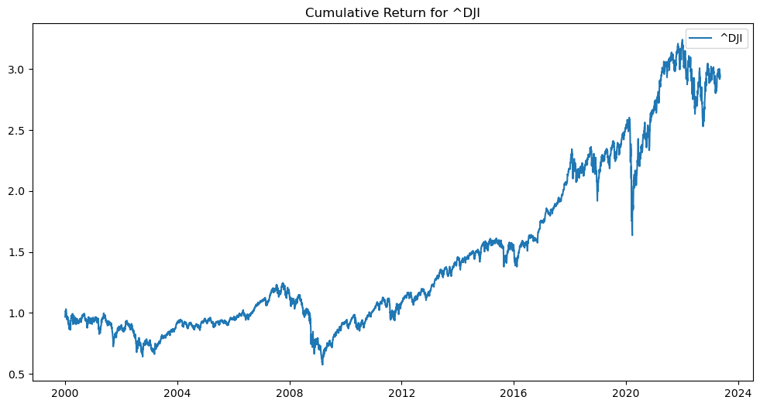
Dow Jones Industrial Ave
The Dow Jones Industrial Average, or simply the Dow, is a stock market index that tracks the performance of 30 large-cap publicly traded companies in the United States. It's one of the oldest and most widely followed stock market indexes in the world.
Perfomamce
Saturn is a gas giant and has several rings

Slide 8
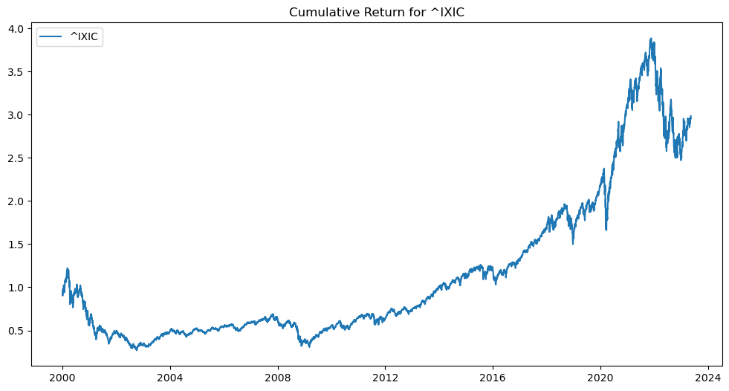
NASDAQ Composite
The NASDAQ Composite is a stock market index that tracks the performance of over 3,000 publicly traded companies that are listed on the NASDAQ stock exchange. It's heavily weighted towards technology companies and is often used as a benchmark for the performance of the tech sector.
Perfomamce
Saturn is a gas giant and has several rings

Slide 9
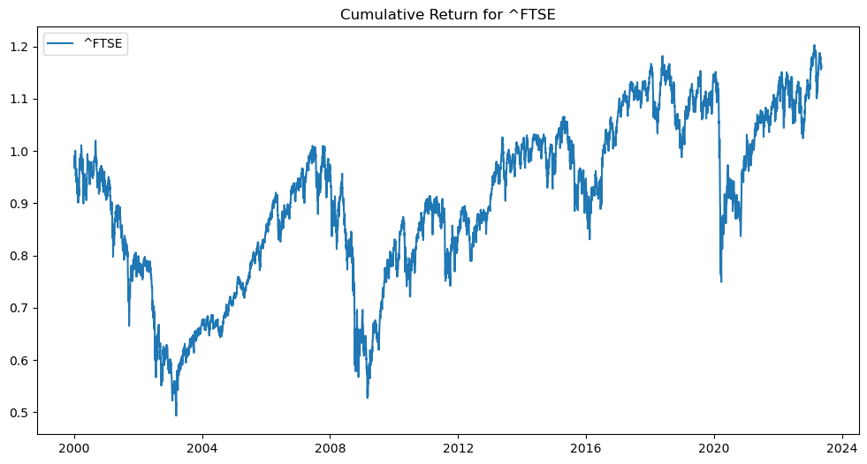
FTSE 100
The FTSE 100 is a stock market index that tracks the performance of the 100 largest companies listed on the London Stock Exchange in the United Kingdom. It's widely regarded as a barometer of the UK stock market.
Perfomamce
Saturn is a gas giant and has several rings

Slide 10
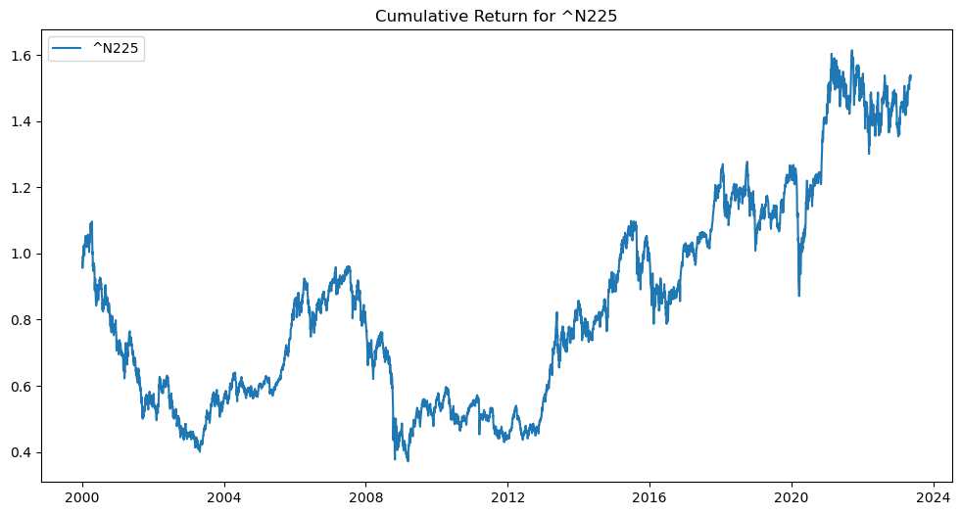
Nikkei 225
The Nikkei 225 is a stock market index that tracks the performance of 225 large-cap publicly traded companies listed on the Tokyo Stock Exchange in Japan. It's one of the most widely followed indexes in Asia.
Perfomamce

Slide 11
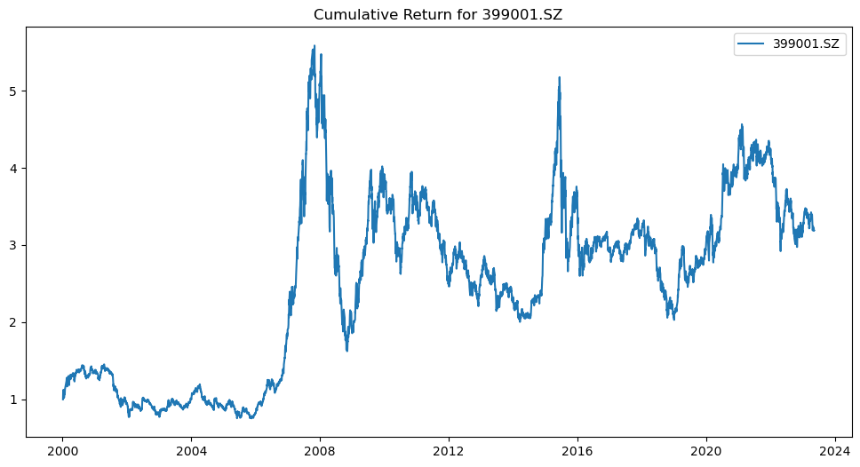
Shenzhen Composite
The Shenzhen Composite is a stock market index that tracks the performance of over 1,700 publicly traded companies listed on the Shenzhen Stock Exchange in China. It's heavily weighted towards technology and manufacturing companies.
Perfomamce

Slide 12
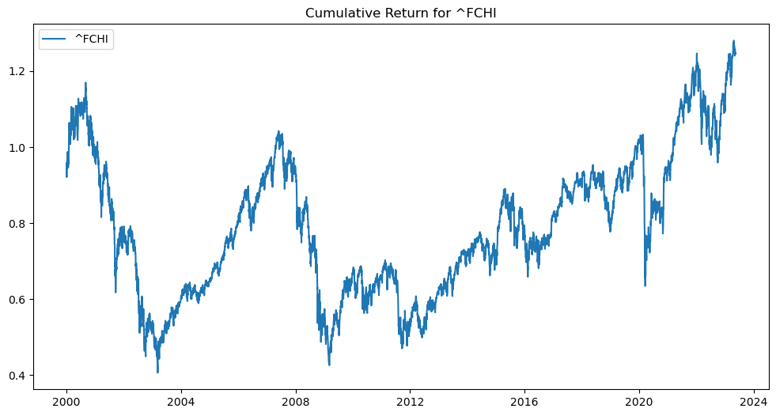
CAC 40 Index (France)
CAC 40 is a stock market index that tracks the performance of the 40 largest companies listed on the Euronext Paris stock exchange in France. It's widely regarded as a barometer of the French stock market.
Perfomamce

Slide 13
Final Choice of Investments
1. FTSE 100 (UK market)
2. Dow Jones Industrial Ave
3. S&P 500

Slide 14
This is because:
The 3 best investments based on the lowest mean squared error are:
1. ^FTSE from 2023-01-01 to 2023-12-31
2. ^DJI from 2023-01-01 to 2023-12-31
3. ^GSPC from 2023-01-01 to 2023-12-31

Slide 15
But Why?
Global Recognition: The FTSE, DOW, and S&P 500 are globally recognized indices, widely tracked by investors, financial professionals, and media outlets worldwide. Their popularity and global reach make them valuable benchmarks for comparing investment performance and analyzing market trends on an international scale.
Performance Track Record: These indices have historically delivered competitive returns over the long term. While past performance does not guarantee future results, the consistency and overall positive performance of these indices over time have contributed to their reputation as attractive investment options.

Slide 16
Why?
After considering both quantitative and qualitative factors, I recommend investing in the FTSE 100. While all three indexes had low mean squared errors, the FTSE 100 performed consistently well over a longer period of time, indicating a more stable investment option.
Furthermore, with Brexit uncertainty now resolved and the UK economy showing signs of recovery from the pandemic, investing in the FTSE 100 is a good option for the long term. The UK government's focus on renewable energy and technology sectors also suggests potential growth in those areas.

Slide 17
Environmental factors
Environmental factors can play a significant role in the performance of markets. Some environmental factors that can affect the performance of the FTSE 100, Dow Jones Industrial Average, and S&P 500 include:
Political climate: Changes in government policies, trade agreements, and political stability can all affect the performance of these markets.
Economic conditions: Economic conditions such as inflation, interest rates, and unemployment rates can all impact the performance of these markets.
Social factors: Social factors such as demographics, consumer behavior, and cultural shifts can also have an impact on market performance.
Environmental factors: Environmental factors such as natural disasters and climate change can have a significant impact on industries that make up these markets, such as energy and agriculture.
Technological advancements: Technological advancements can lead to disruptive innovation, which can impact entire industries and affect the performance of markets.
It is important to consider these environmental factors when analyzing the performance of these markets, as historical performance is not a guarantee of future performance.

Slide 18

Investment Projections

Slide 19
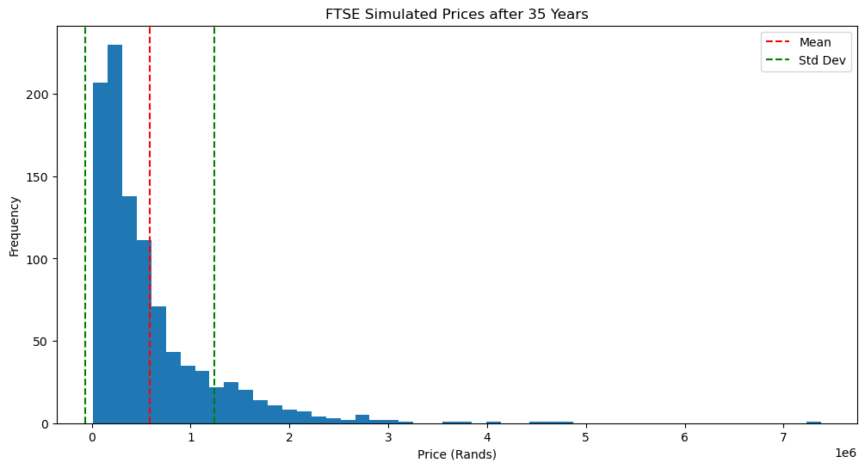
FTSE 100 (UK market) Investment
Perfomamce
Investment amount: R60000
Investment period: 35 years
Current price: R161182.72
Mean simulated price: R587114.93
Standard deviation of simulated prices:R656002.6
Future price in 35 years: R12188505.98
Investment amount in 35 years:R583758.69

Slide 20
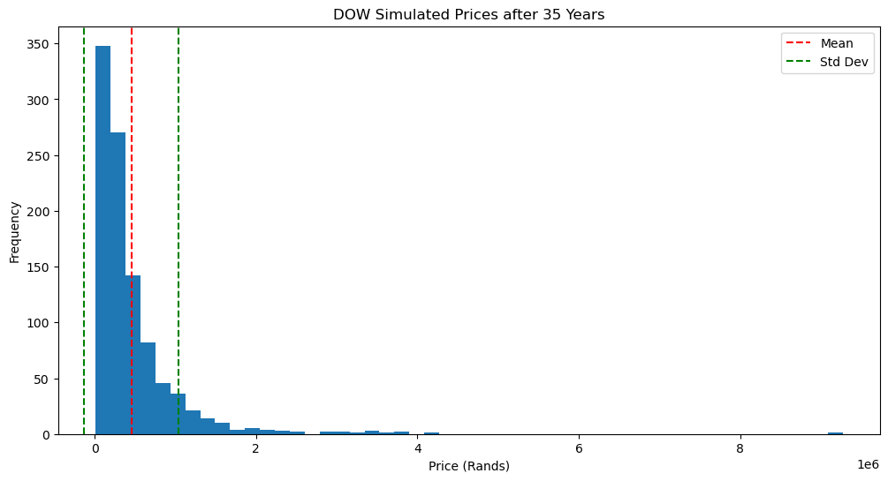
Dow Jones Industrial Ave
Perfomamce
Investment amount: R20000
Investment period: 35 years
Current price: R696743.15
Mean simulated price: R455457.1
Standard deviation of simulated prices:R584720.76
Future price in 35 years: R9455289.47
Investment amount in 35 years:R421545.25

Slide 21
S&P 500
Perfomamce
Investment amount: R20000
Investment period: 35 years
Current price: R85513.97
Mean simulated price: R530067.87
Standard deviation of simulated prices:R584343.85
Future price in 35 years: R11004209.04
Investment amount in 35 years:R576059.21

Slide 22
—Conclusion
This investment was done on a 60%-20%-20% Investment, respectively.

Slide 23
Learnings
We have learned a lot about markets, indexes, and data analysis through this course. We now understand how indexes work and how they are used as benchmarks for measuring the performance of a particular market or asset class. We have also learned how to analyze data quantitatively and qualitatively, which is an important skill for making informed investment decisions.
Our programming skills have also improved significantly through this course. We have learned how to use Jupyter notebooks to analyze data, create visualizations, and make recommendations based on our analysis. We have also learned how to use APIs to retrieve historical data for various markets, which is a valuable skill for conducting market research.
Overall, this course has provided us with a solid foundation in finance, data analysis, and programming skills, which will be useful in a variety of fields. We have gained a deeper understanding of how financial markets work and how to make informed investment decisions. We look forward to applying these skills and knowledge in our future endeavors.

Slide 24
Thank You
Chadrack Mulamba- 219001710
Buhle Maphela -217076335
Eugene Ndlovu-219085513

